Slide 1

SESSION 3
The secret to viral writing
By Shaan Puri
POWER WRITING COURSE

Slide 2

The Toolbox
Session 1: Writing an email to someone you don’t know
Session 2: What you do
Session 3: Writing content to go viral to grow either your brand or your company’s brand
5/36 SHAANPURI.COM POWER WRITING COURSE

Slide 3
There are 2 Parts to Viral Writing
IDEAS - Having a steady stream of great ideas (what to write about)
PACKAGING - Knowing how to package it up for virality
5/36 SHAANPURI.COM POWER WRITING COURSE
Notes:
It came from 5 threads, one a month.

Slide 4
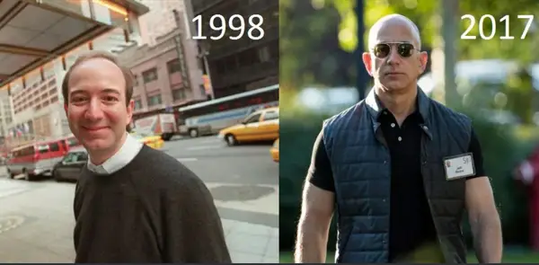
You now
You in 1 hour
No content ideas
No idea how to make them go viral
Pipeline FULL of content ideas
Know how to add viral sauce
5/36 SHAANPURI.COM POWER WRITING COURSE
Notes:
It came from 5 threads, one a month.

Slide 5
Finding stuff to write about...
6/36 SHAANPURI.COM POWER WRITING COURSE

Slide 6
B...bu...but… I’m not an expert!
What do I write about?
6/36 SHAANPURI.COM POWER WRITING COURSE

Slide 7
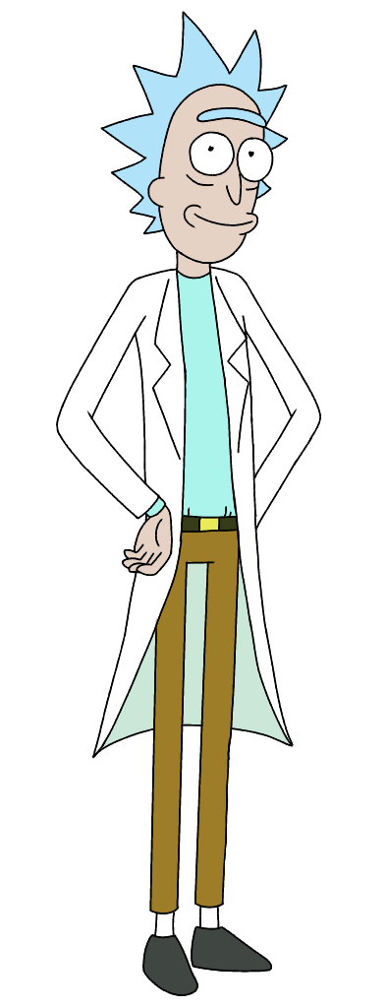

Types of Content Creators
Curious Beginner
2
Generous expert
1
9/36 SHAANPURI.COM POWER WRITING COURSE
Notes:
Curious beginner

Slide 8
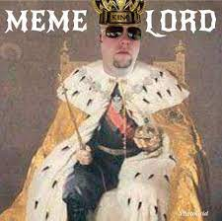
Types of Content Creators
(+ Stunt Devils
+Analysts with Attitude & Meme lords)
9/36 SHAANPURI.COM POWER WRITING COURSE
Notes:
Curious beginner

Slide 9


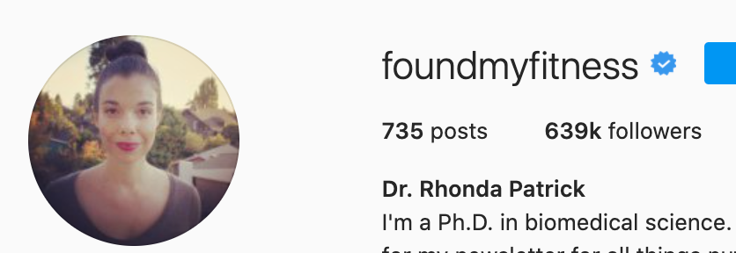
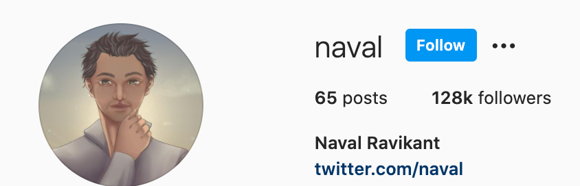
Generous Experts
9/36 SHAANPURI.COM POWER WRITING COURSE
Notes:
Curious beginner

Slide 10

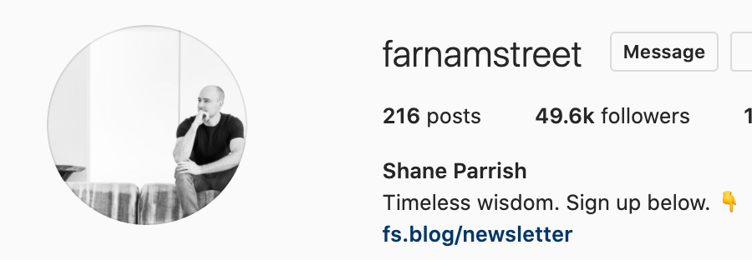
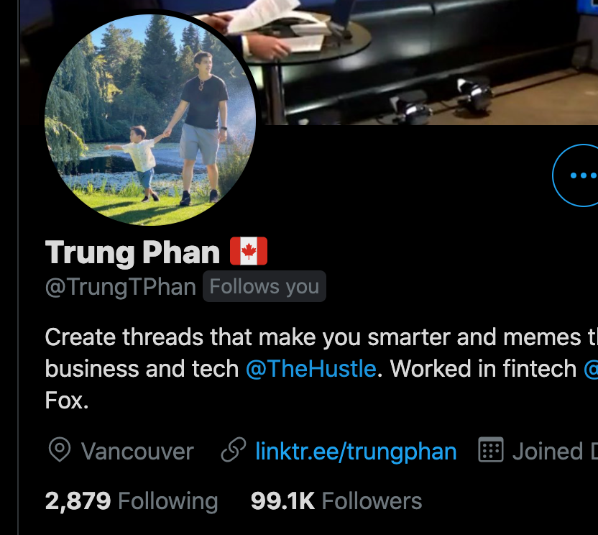

Curious Beginners
Curious Beginner
2
9/36 SHAANPURI.COM POWER WRITING COURSE
Notes:
Curious beginner

Slide 11

You’re an expert in your life experiences
And you’re a beginner in everything else.
STORIES BANK
10/36 SHAANPURI.COM POWER WRITING COURSE

Slide 12
Content generator
Job | Investment | Skill | Thing I learned | Advice | Book | Thing I made | Side hustle
First → ________
Last → ________
Best → ________ Worst → ________ Weirdest → ________
11/36 SHAANPURI.COM POWER WRITING COURSE

Slide 13
Content generator: Jeffrey
Job | Investment | Skill | Thing I learned | Advice | Book | Thing I made | Side hustle
First → Bailing hay
Last → build houses
Best → Raft guide in tennessee Worst → Ad agency strategist Weirdest → English teacher in Mongolia
11/36 SHAANPURI.COM POWER WRITING COURSE
Notes:
1,000 bails/day → $35k at 12, you deal hay to horse track and horse owners
Juniro strategist - most people are shitbaggers
If you don’t want your bosses job, then you need a new job

Slide 14
Example: Bebo
Milestones | Hire | Customer | Growth Tactic | Mistake | Investor| Product or Feature | Competitor | Ad | Office
First →
Last →
Best →
Weirdest →
11/36 SHAANPURI.COM POWER WRITING COURSE

Slide 15
ACTION TIME… Make yours: https://swiy.io/pwcontentgenerator
^make a copy in google docs
First →
Last →
Best → Worst → Weirdest →
12/36 SHAANPURI.COM POWER WRITING COURSE

Slide 16
First Side Hustle → Black jack card counting on riverboat
Last Side Hustle → Podcast
Best Side Hustle → All access pass
Worst Side Hustle → Black jack card counting
Weirdest Side Hustle → Fat bands
Example: Shaan Puri @shaanvp
Content ideas:
My 48 hour side hustle (Fat Bands)
Card Counting Gone Wrong (funny story)
How to have a full time job but only work a couple hours a week
Why I shut down a newsletter making $50k/month
15/36 SHAANPURI.COM POWER WRITING COURSE

Slide 17
Everyone is an “expert” from their own life experiences.
You don’t need to be a billionaire to teach what you know!
Use:
Personal experiences
Small stories
First hand knowledge
Curiosity (go down rabbit holes, then summarize what you find)
16/36 SHAANPURI.COM POWER WRITING COURSE

Slide 18
Curious Beginner
“I want to know X”
“I’m going to deep dive”
“Follow along” (build in public, learn in public)
17/36 SHAANPURI.COM POWER WRITING COURSE

Slide 19
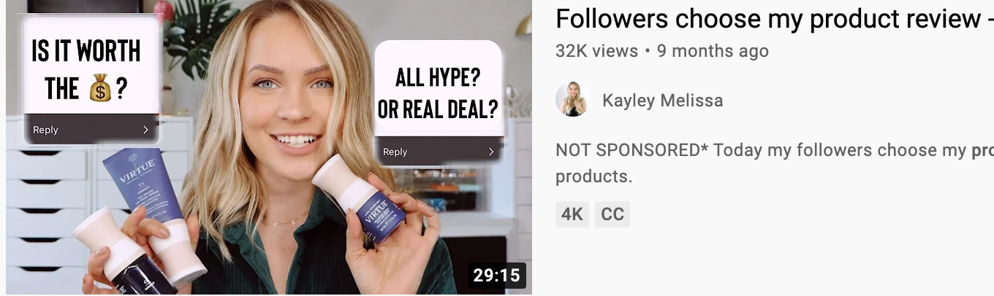
Curious Beginner
Sleeping w/ Zach
18/36 SHAANPURI.COM POWER WRITING COURSE

Slide 20

Mining for Gold
12/36 SHAANPURI.COM POWER WRITING COURSE

Slide 21

19/36 SHAANPURI.COM POWER WRITING COURSE

Slide 22
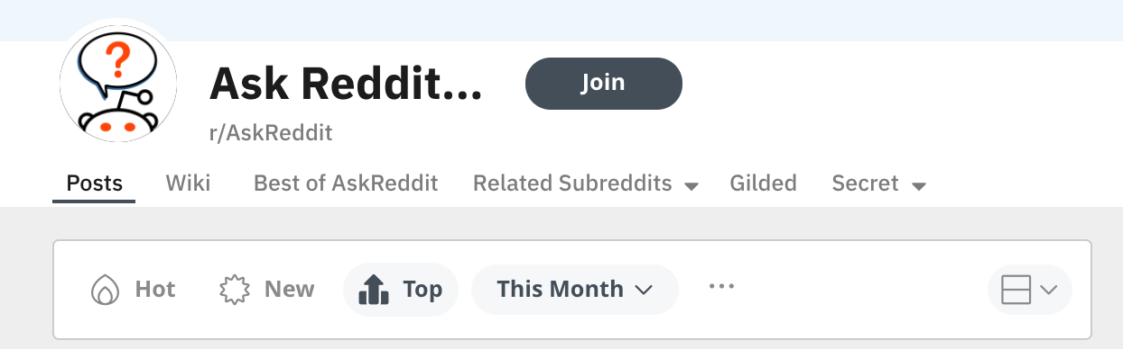
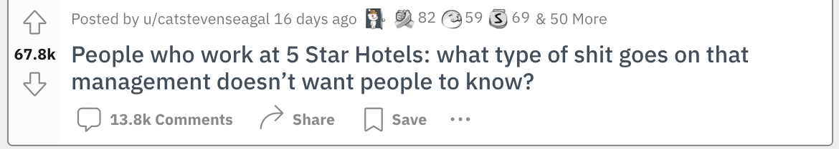
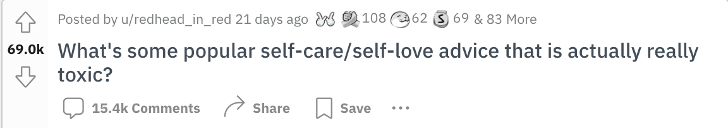
r/FatFire
etc...
r/YouTubeHaiku
r/AskReddit
r/MidlyInteresting
19/36 SHAANPURI.COM POWER WRITING COURSE

Slide 23
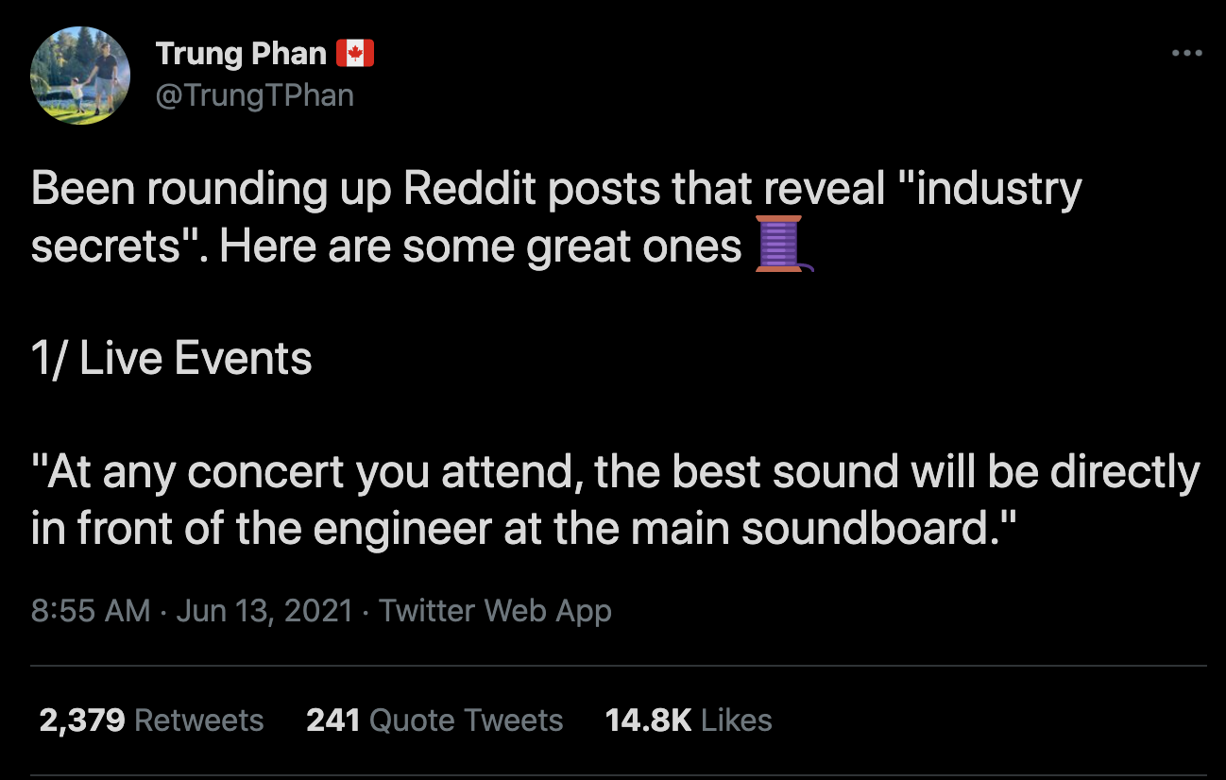
19/36 SHAANPURI.COM POWER WRITING COURSE

Slide 24
But if it’s already written..
Why should I write about it?
23/36 SHAANPURI.COM POWER WRITING COURSE

Slide 25
The internet is a big and noisy place.
99% of people don’t see the best stuff.
(and even if they do, you can remix, simplify, or package it in a new way to a new group of people)
23/36 SHAANPURI.COM POWER WRITING COURSE

Slide 26
OK… so you have content ideas…
Now what?
24/36 SHAANPURI.COM POWER WRITING COURSE

Slide 27
OK … so now I know what to talk about..
what’s the secret to going viral?
25/36 SHAANPURI.COM POWER WRITING COURSE

Slide 28
What’s the FIRST thing you do when you start writing?
Stare at blank page
Start procrastinating (cleaning, eating, youtube, etc.)
Start writing the first paragraph
Write an outline?
None of the above?
25/36 SHAANPURI.COM POWER WRITING COURSE

Slide 29
None of the above!
26/36 SHAANPURI.COM POWER WRITING COURSE

Slide 30

The first thing to do, is to decide what reaction you want the reader to have.
27/36 SHAANPURI.COM POWER WRITING COURSE

Slide 31
Key word: “Reaction”
It’s ok if they hate it. It’s ok if they love it. As long as they don’t ignore it.
28/36 SHAANPURI.COM POWER WRITING COURSE

Slide 32
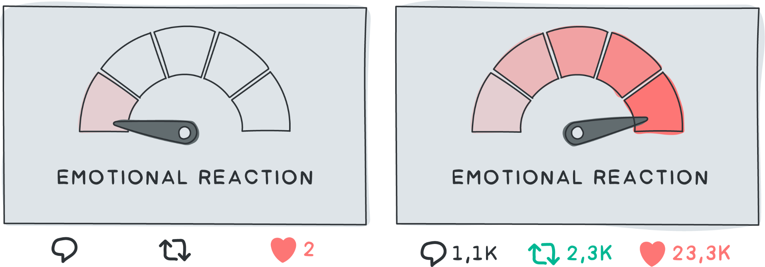
2/36 SHAANPURI.COM POWER WRITING COURSE
Power writers want action. Action comes from emotion.

Slide 33
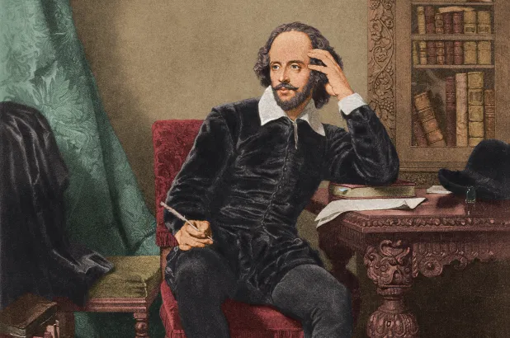

This is not your audience.
Literary Critic
School Teacher
29/36 SHAANPURI.COM POWER WRITING COURSE

Slide 34


This is.
Debbie at her Desk
Jenny in her bedroom
30/36 SHAANPURI.COM POWER WRITING COURSE

Slide 35
How most people write
How Viral Writers write
“ Hmmm.. what reaction do I want the reader to have?”
That’s what gets Jenny in her bedroom
Want to share with her friends
That’s what gets Debbie who’s bored at her desk, share with her coworkers
“ Hmmm.. What do i want to say?”
30/36 SHAANPURI.COM POWER WRITING COURSE

Slide 36
Most people think writing is about words & information
That’s true, for encyclopedias
30/36 SHAANPURI.COM POWER WRITING COURSE

Slide 37



Normal writers
Power writers
34/36 SHAANPURI.COM POWER WRITING COURSE
Notes:
Power writers - convey an emotion

Slide 38
Why go for emotion?
“95% of decision making takes place in the subconscious mind - from emotions not rational logic” - Harvard Business School
34/36 SHAANPURI.COM POWER WRITING COURSE
Notes:
Power writers - convey an emotion

Slide 39

2/36 SHAANPURI.COM POWER WRITING COURSE

Slide 40
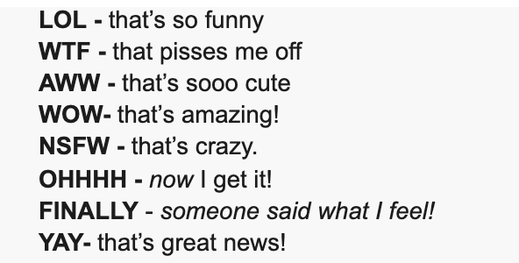
So.. how do I do it?
2/36 SHAANPURI.COM POWER WRITING COURSE
There are 8 core emotions that power writers target:

Slide 41
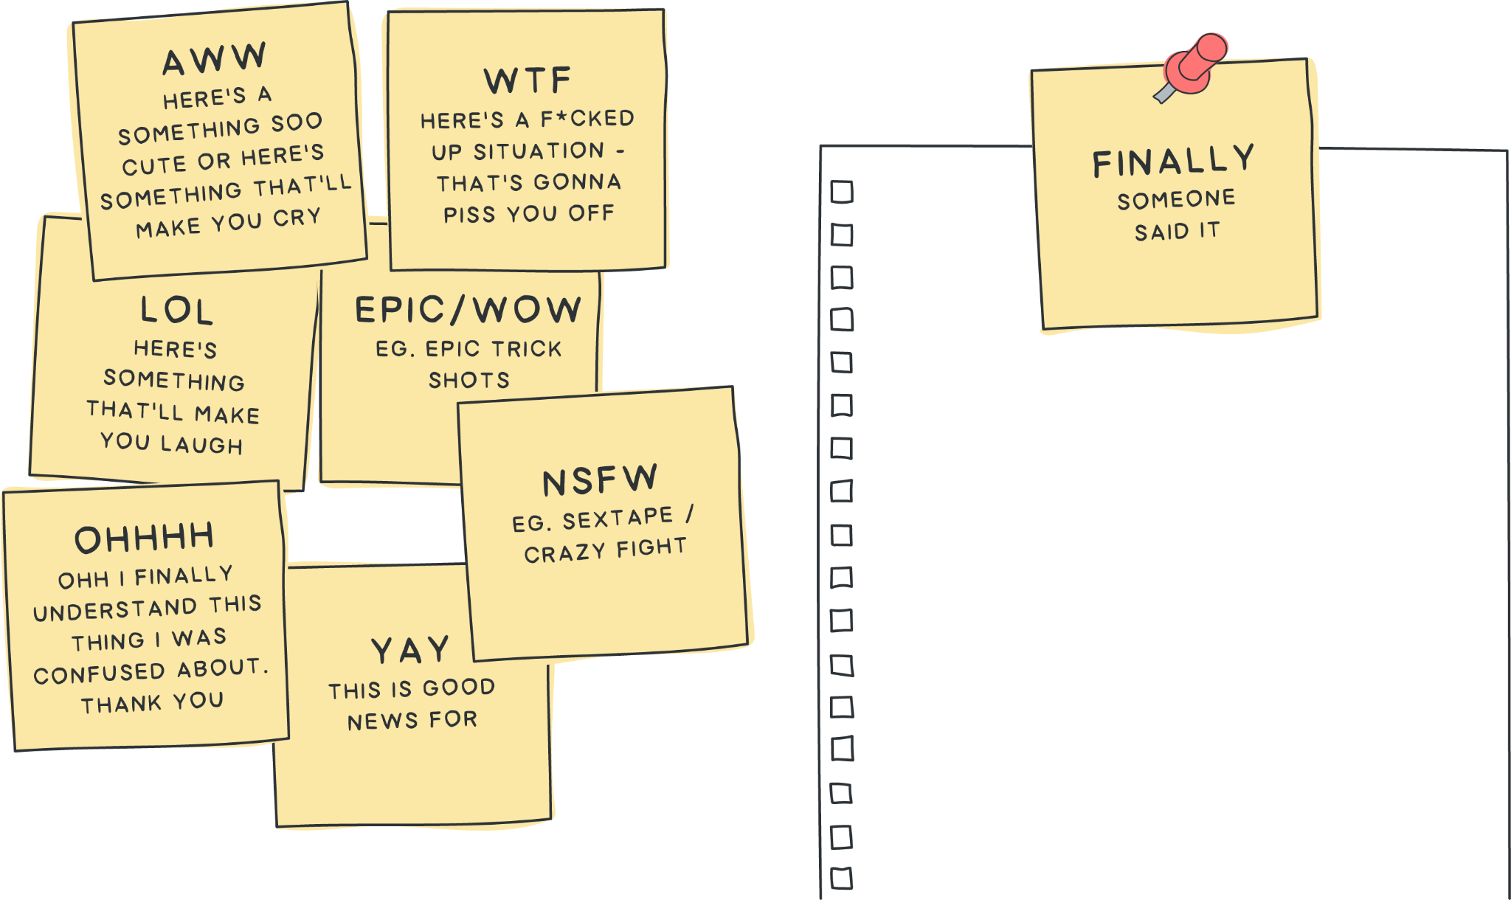
2/36 SHAANPURI.COM POWER WRITING COURSE
How you should use this framework

Slide 42
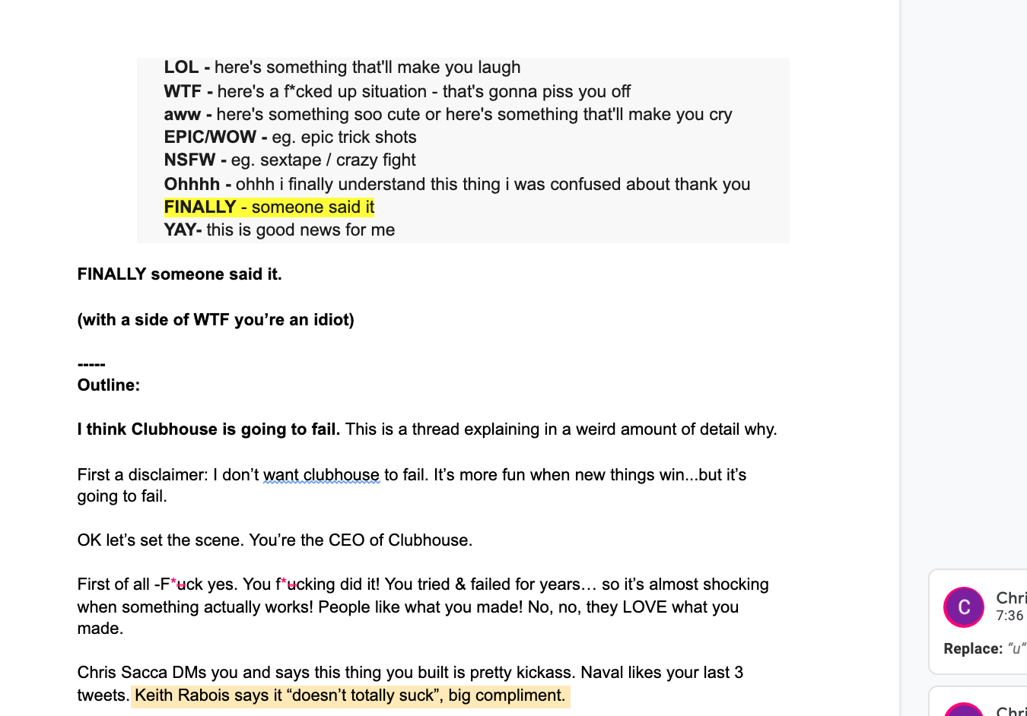
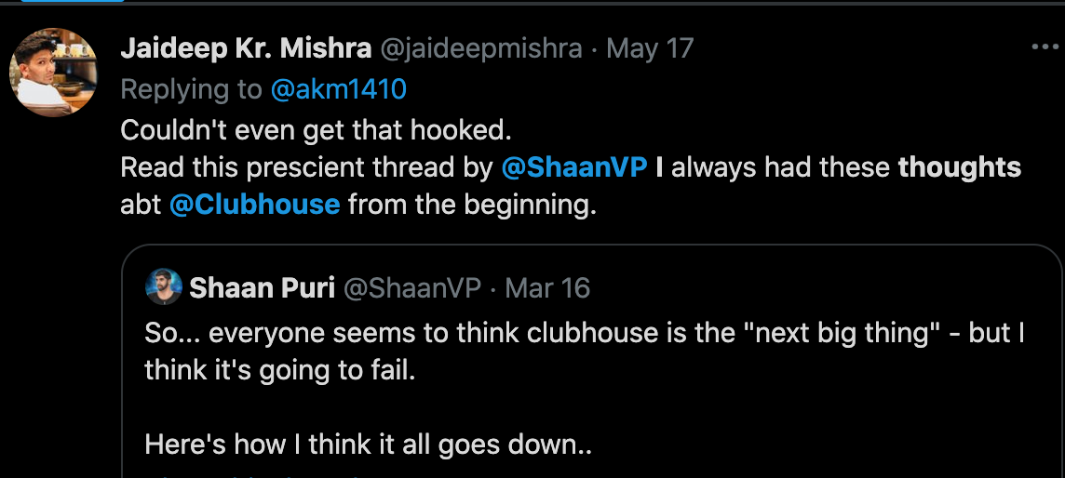
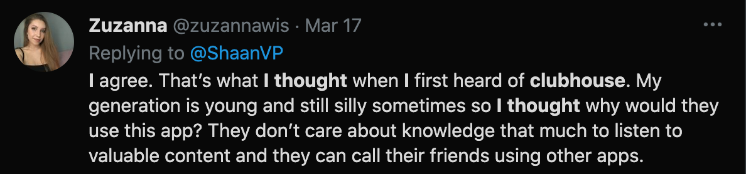
2/36 SHAANPURI.COM POWER WRITING COURSE
Example: This is my draft for the clubhouse thread I wrote that went super viral (10M+ views)

Slide 43

Even though you know the technique
You’ll suck at first.
2/36 SHAANPURI.COM POWER WRITING COURSE
It takes practice to be able to hit those emotions.

Slide 44
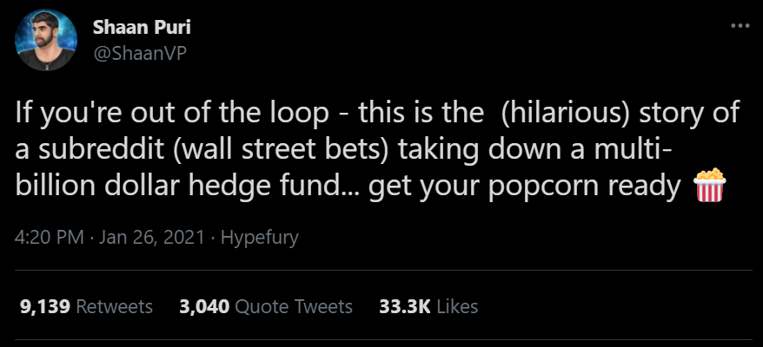
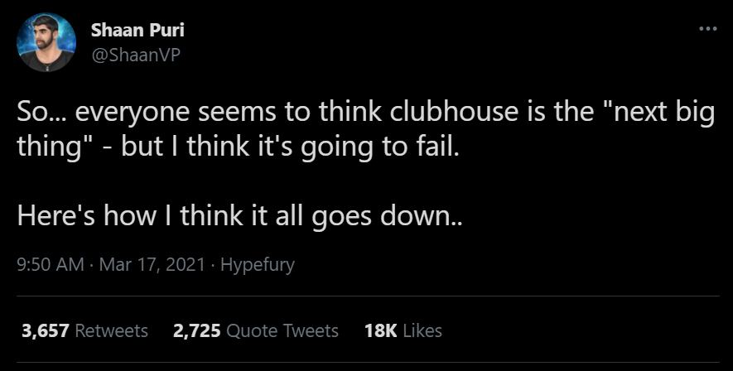
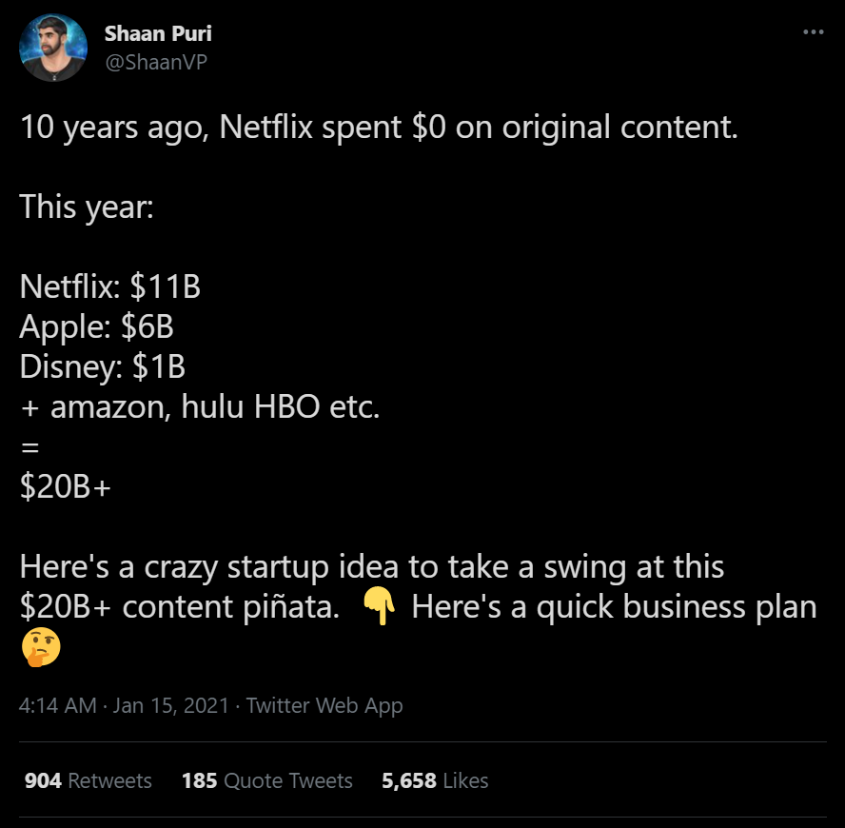
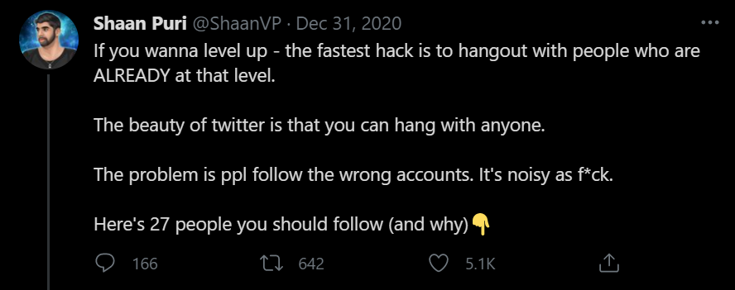
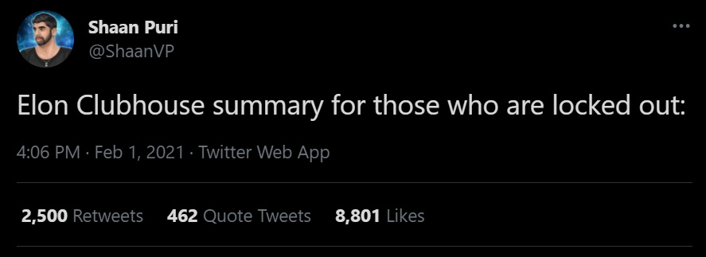
Nope. I tried to go viral. 20 attempts, 5 Hits
*Click on the tweets to view in Twitter
4/36 SHAANPURI.COM POWER WRITING COURSE

Slide 45


Let that sink in
That didn’t come from constantly tweeting 10x a day.
It came from 5 threads, 1x a month.
That’s the power of viral content
Don’t be this guy
Be this guy
5/36 SHAANPURI.COM POWER WRITING COURSE

Slide 46
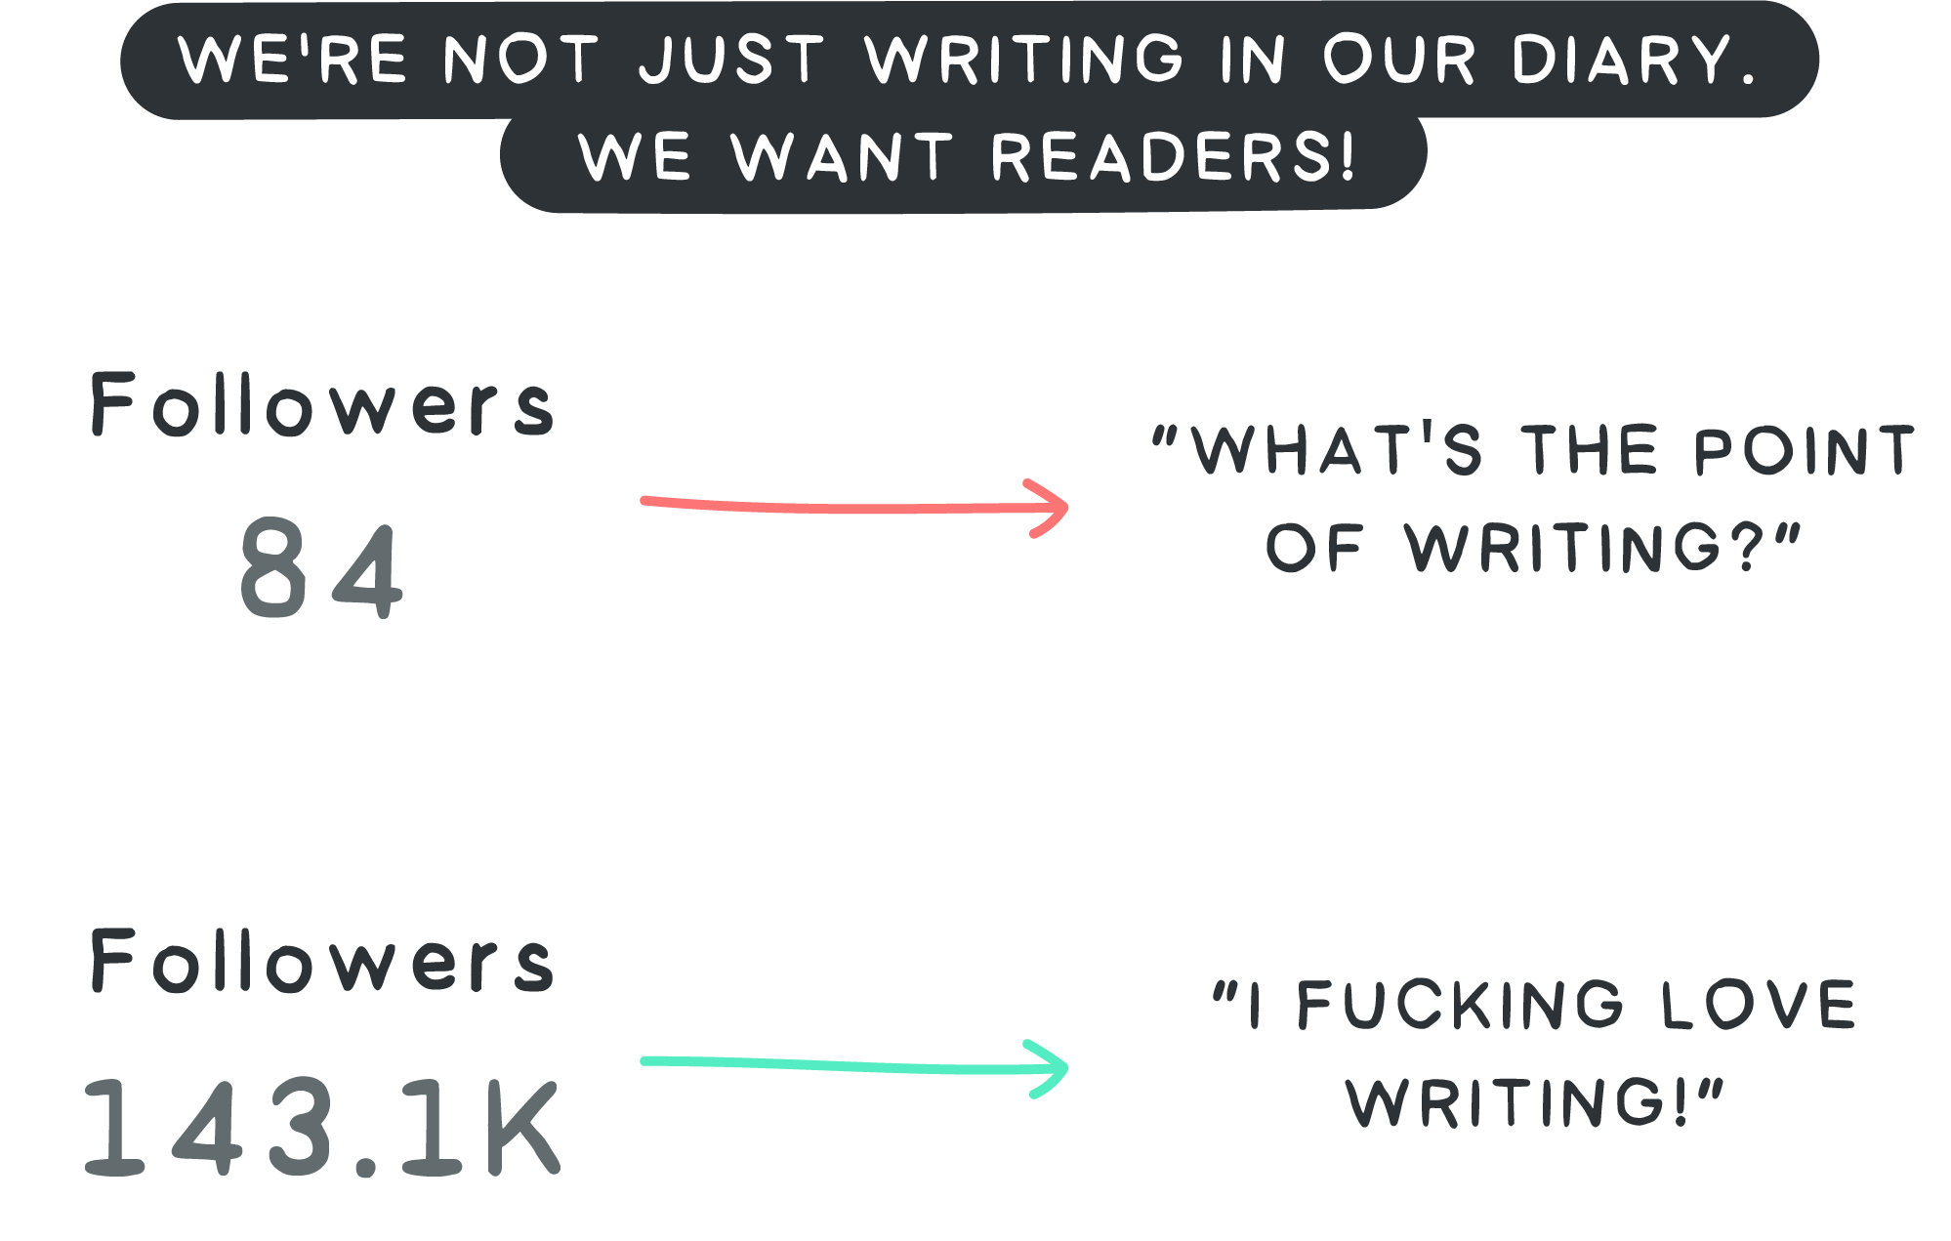
2/36 SHAANPURI.COM POWER WRITING COURSE

Slide 47
2/36 SHAANPURI.COM POWER WRITING COURSE
Going viral on Twitter..
Need a brave volunteer

Slide 48
2/36 SHAANPURI.COM POWER WRITING COURSE
THE HOOK

Slide 49
2/36 SHAANPURI.COM POWER WRITING COURSE
What is the goal of the 1st tweet you write?

Slide 50
2/36 SHAANPURI.COM POWER WRITING COURSE
The goal of tweet 1
Is to get you to read tweet 2

Slide 51
2/36 SHAANPURI.COM POWER WRITING COURSE
The goal of tweet 2
Is to get you to read tweet 3

Slide 52
2/36 SHAANPURI.COM POWER WRITING COURSE
This creates a slippery slope. Instead of begging people to read
Readers are begging you for the payoff

Slide 53
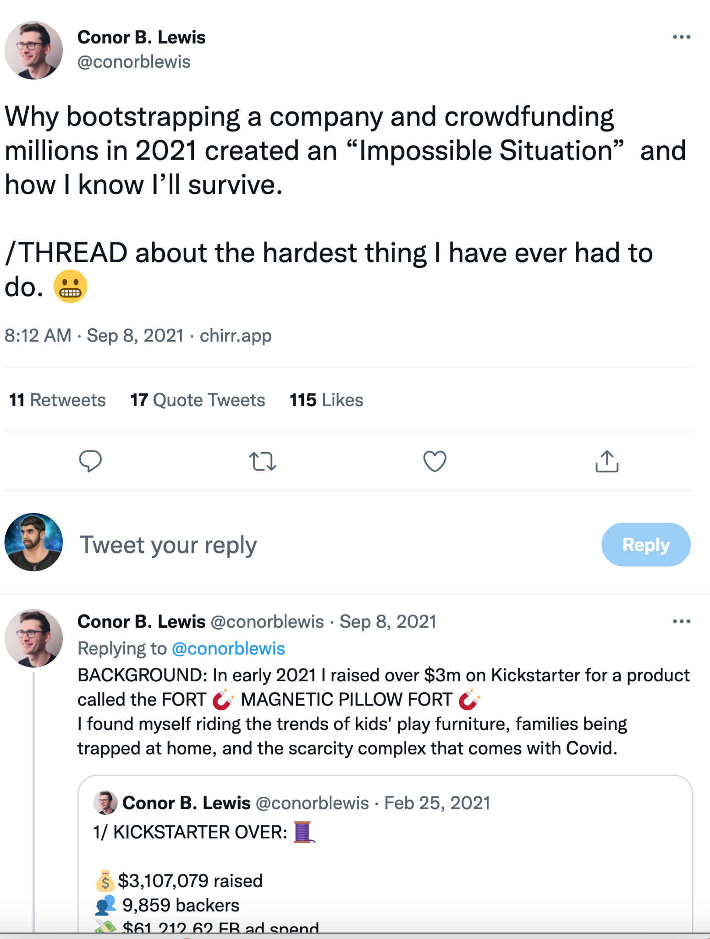
2/36 SHAANPURI.COM POWER WRITING COURSE
Let’s re-write the thread
I haven’t talked about this publicly ever..but finally, I’m ready to do it. This is the crazy story of how I raised $3M on kickstart for just an idea in my head…and screwed myself into an “Impossible Situation”

Slide 54
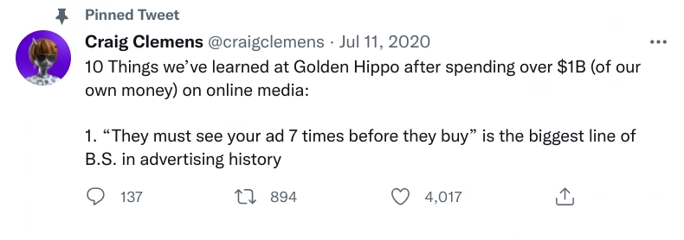
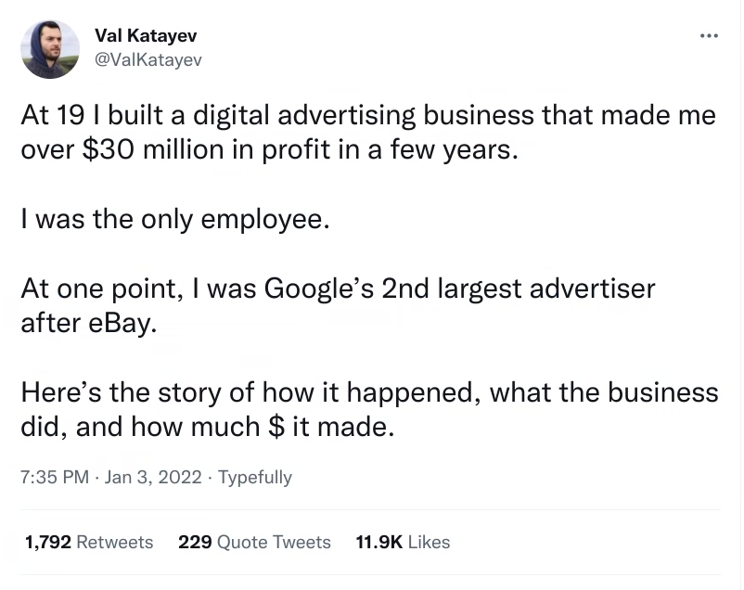
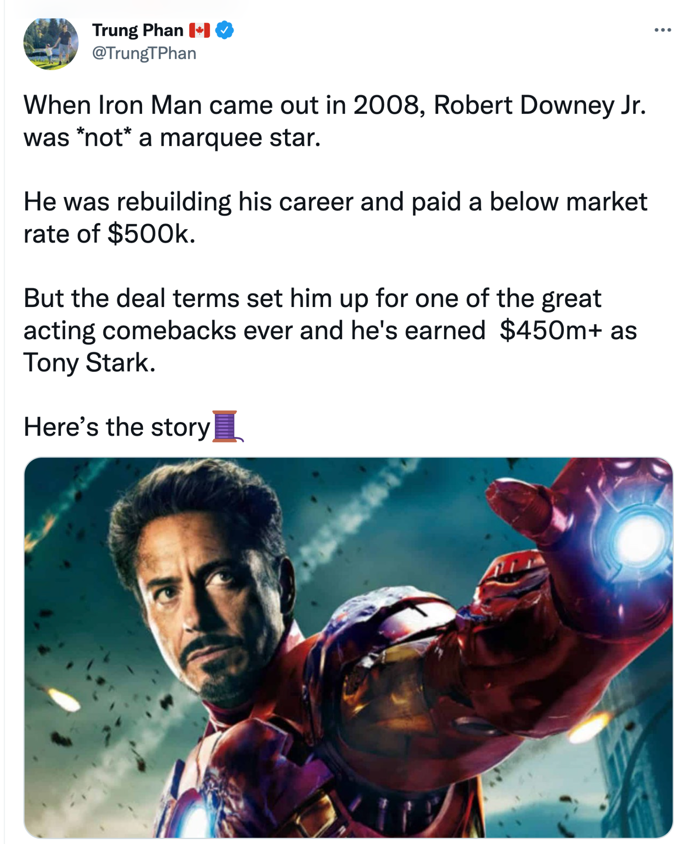
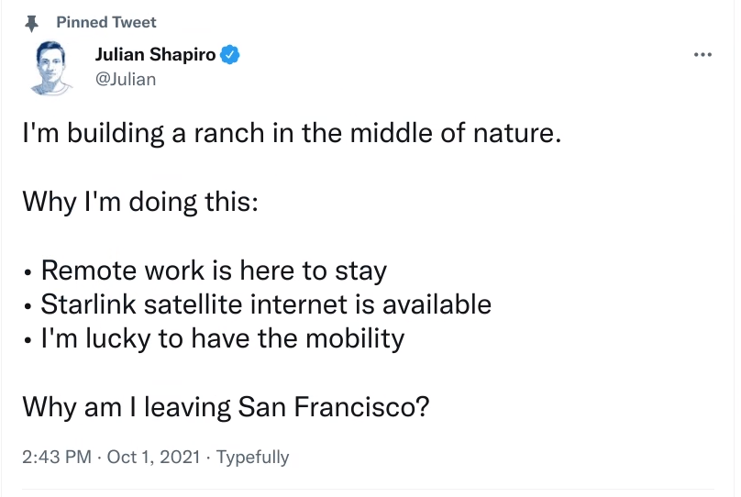
Examples of Great Hooks
34/36 SHAANPURI.COM POWER WRITING COURSE
Notes:
Power writers - convey an emotion

Slide 55
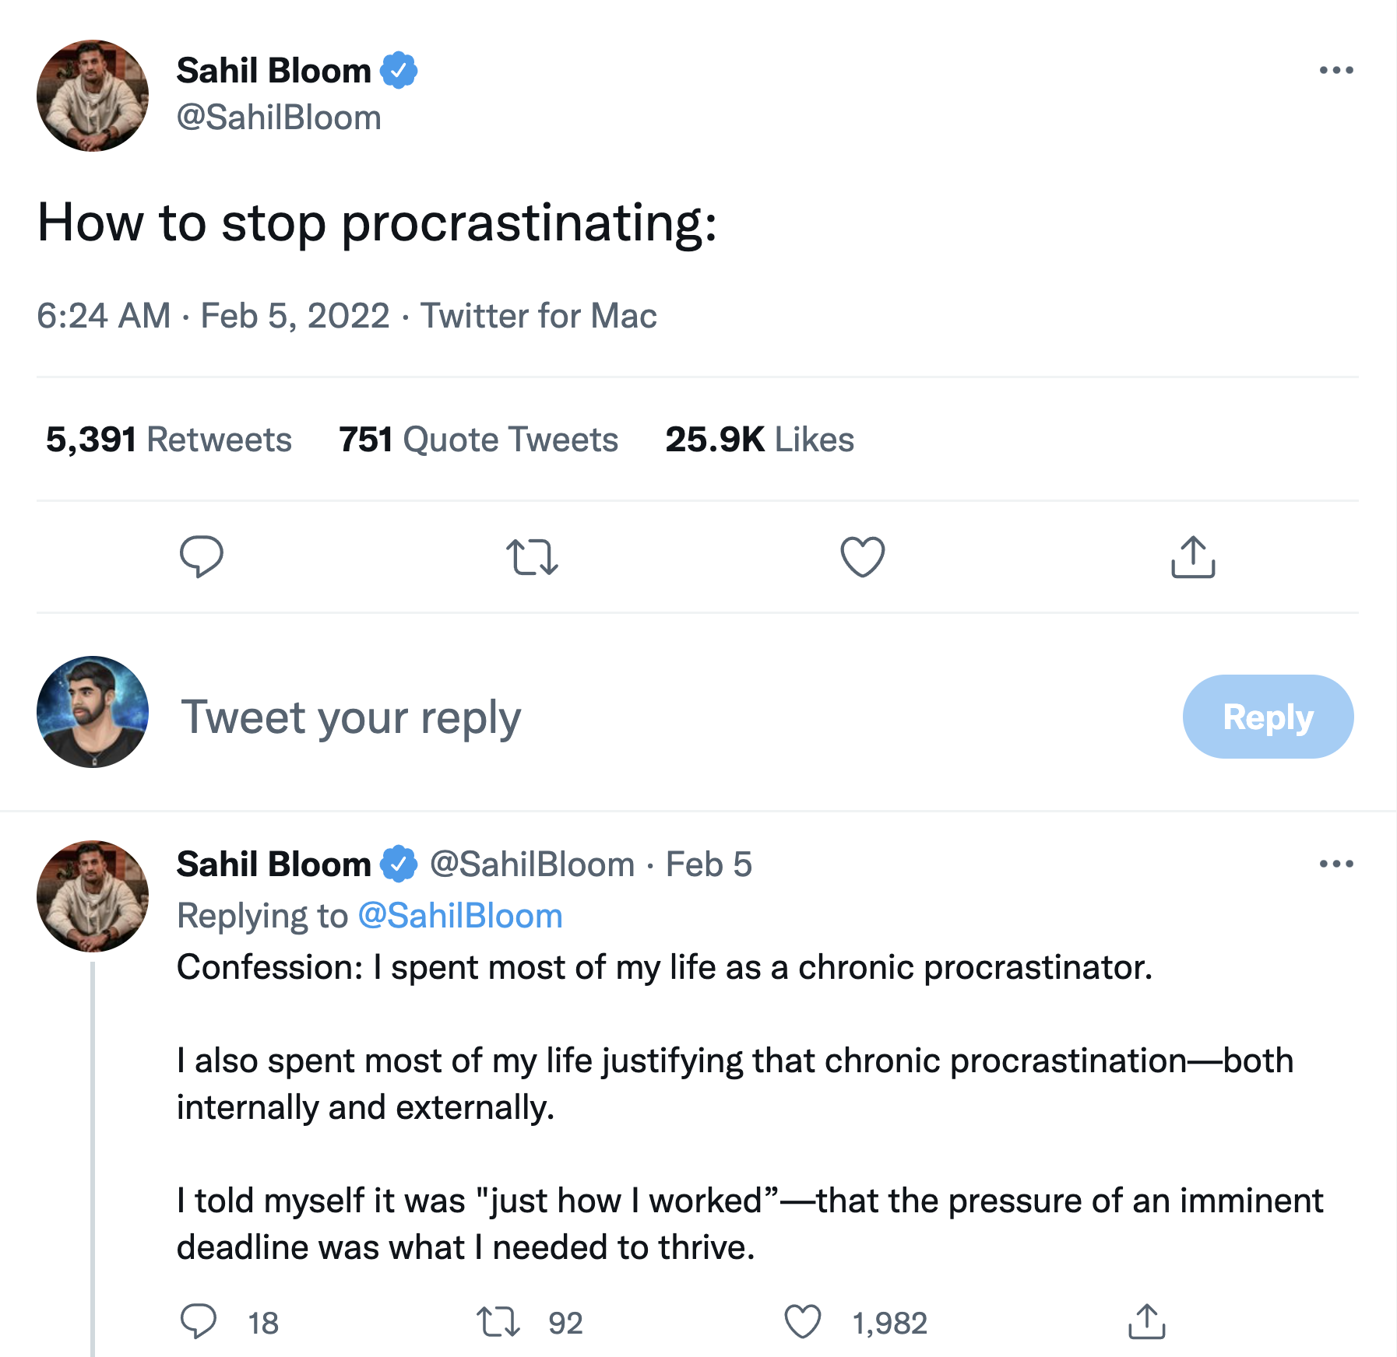
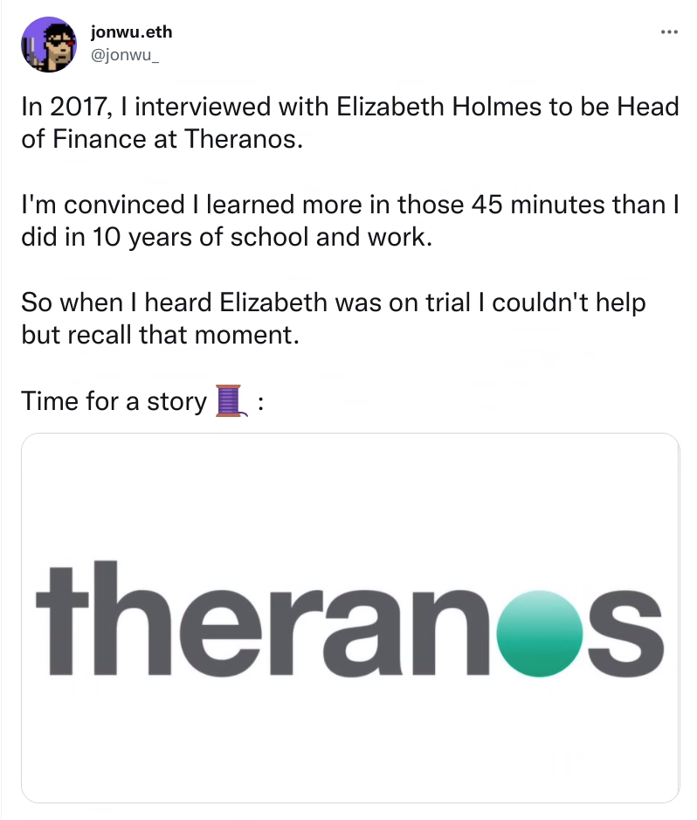

Slide 56
Summary:
2/36 SHAANPURI.COM POWER WRITING COURSE
Writing is more fun & valuable when you have a big audience. Invest in learning how to grow your audience thru viral content.
To go viral, generate interesting ideas and slingshot it with emotion.
To find interesting things, look inwards (personal experiences) or mine the internet for gold you can remix.
When it’s time to write, start with the end reaction you want your reader to have.

Slide 57
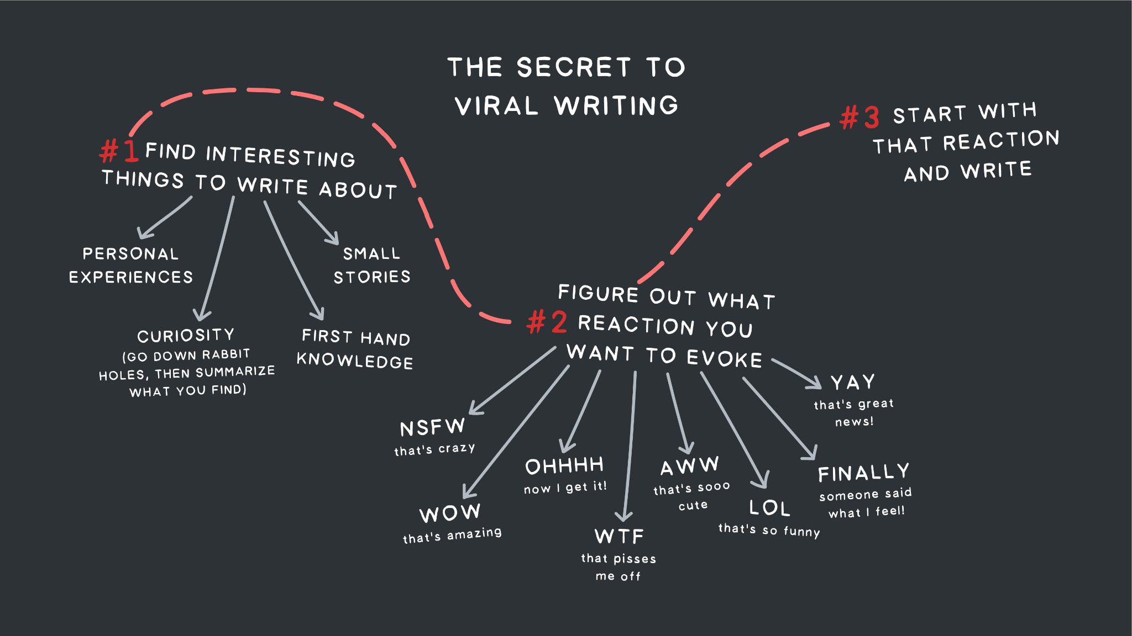

Slide 58
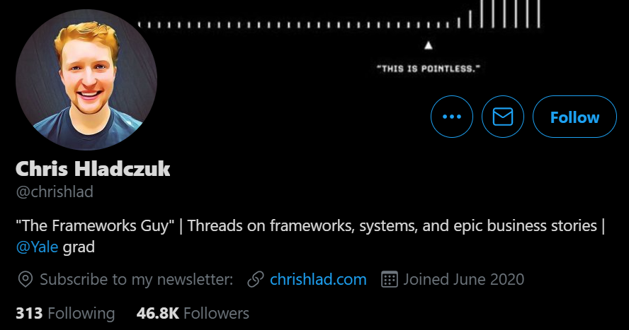
My intern grew from 2k → 48k in 3 months doing the same thing
6/36 SHAANPURI.COM POWER WRITING COURSE

Slide 59
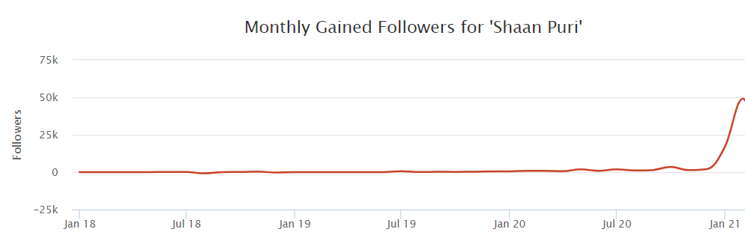
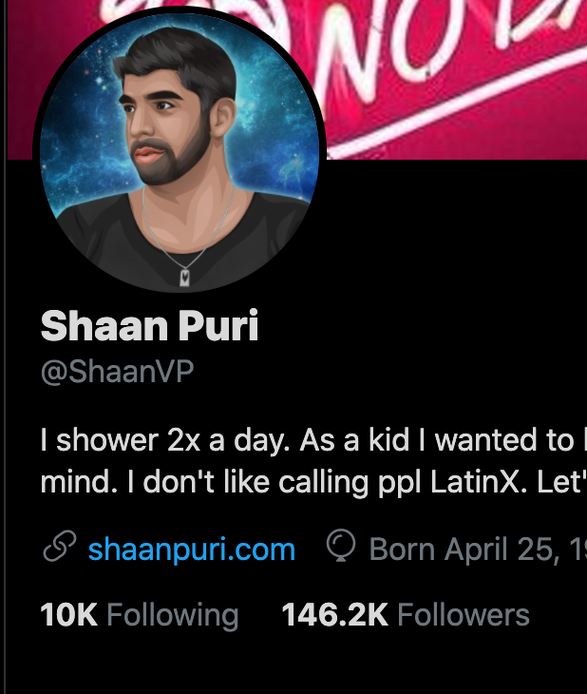
I wanted an audience.
4 months later I had 100k new followers. How?
I “decided” to grow
3/36 SHAANPURI.COM POWER WRITING COURSE

Slide 60
